Slide 1
Introduction / Business Problem
One businesswoman will make an investment at the one of biggest cities of the World.
She wonder which investment types are popular at these cities and can we group these cities by places in the city
She also thinks hotel investment at big cities are popular. Is it true?
Hotel invesment rates compared to other places are about PPP, GDP and Population
I will make a cluster analysis for biggest cities of the World according to places at there, using foursquare api, wikipedia (to find biggest cities of countries)
I think we can make regression analysis GDP vs Hotel Rate, PPP vs Hotel Rate, Population vs Hotel Rate. However, we should look at scatter plots of these.

Slide 2
Data
I will use wikipedia GDP per capita data to find GDPs.
I will use wikipedia PPP data to find PPPs.
I will use biggest cities of countries data to find biggest cities and populations.
I will use latitudes and longitudes of cities data
I will use foursquare api.
https://en.wikipedia.org/wiki/List_of_countries_by_GDP_(nominal)_per_capita
https://en.wikipedia.org/wiki/List_of_countries_by_GDP_(PPP)_per_capita
https://en.wikipedia.org/wiki/List_of_countries_by_largest_and_second_largest_cities
https://simplemaps.com/data/world-cities

Slide 3
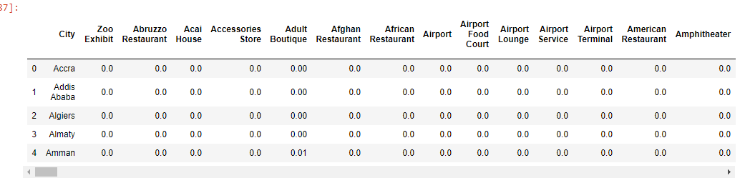
Result Data & Graphs

Slide 4
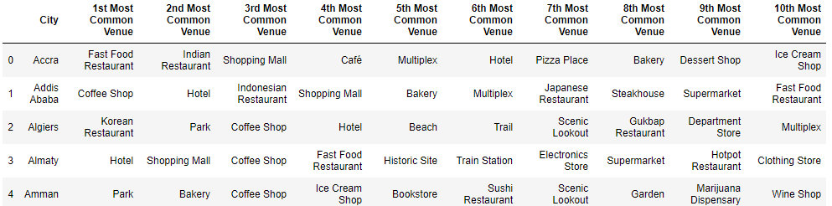
Result Data & Graphs

Slide 5
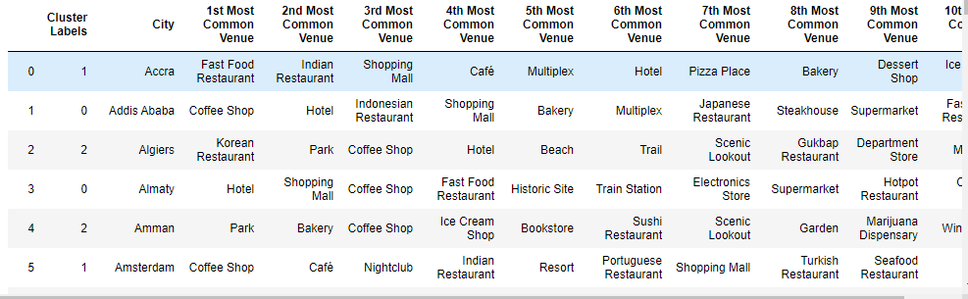
Result Data & Graphs

Slide 6
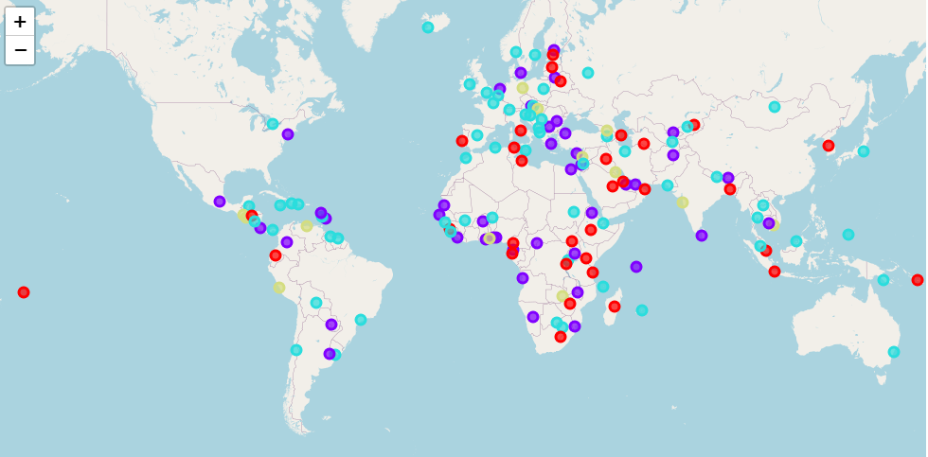
Result Data & Graphs

Slide 7
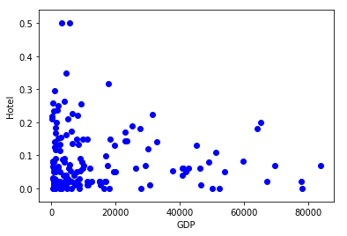
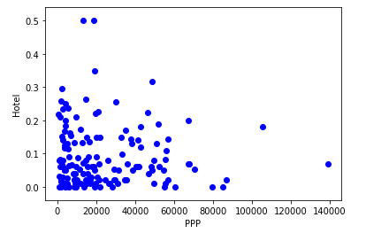
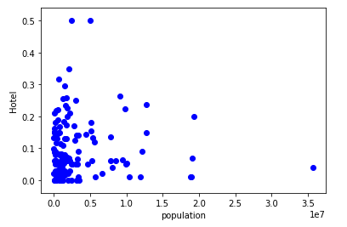
Result Data & Graphs

Slide 8
Result
My observation is Europe and other welfare countries usually in same cluster and African countries, other countries has a pattern.
There is no correlation between GDP, PPP, Population vs Hotel Frequency.

